Slide 1

PRESENTED BY -
AAMLEEN AHMED,
MOHD. SUFYAN AZAM
NETWORK SECURITY
D.E.S.
ENCRYPTION

Slide 2

INTRODUCTION
- Developed by IBM in the 1970s, DES (Data Encryption Standard.) is a symmetric-key encryption algorithm.
- It is a block-wise encryption algorithm that operates on 64-bit blocks of plaintext using a 56-bit key, providing cryptographic security for data transmission.
- DES has been widely used in various applications, although its 56-bit key size has raised security concerns over time.
- In this mini-project, we completely implement the DES Algorithm for Encryption and Decryption. We also verify the algorithm by comparing the complementary (<1,15>, <2,14>, etc) pairs of encryption and decryption outputs.

Slide 3
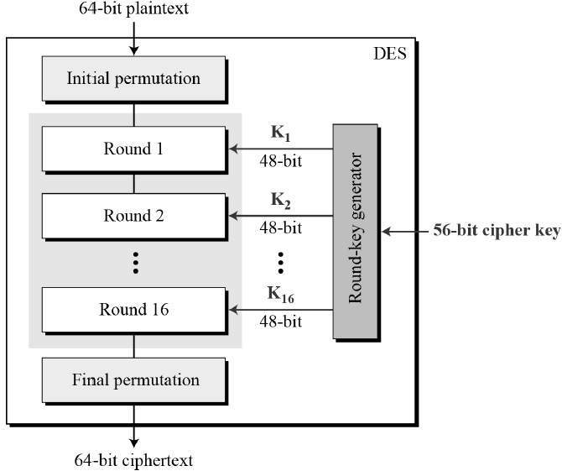
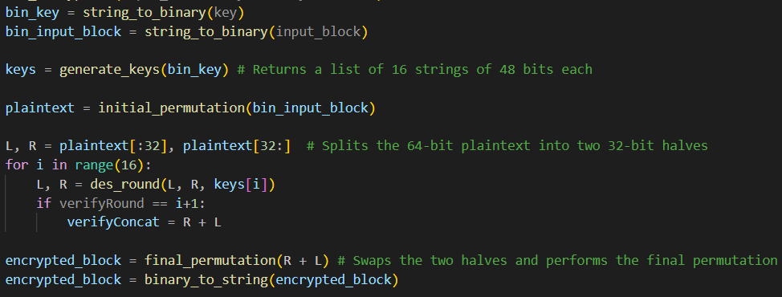
ENCRYPTION STEPS
Initial Permutaion (IP)
Key Generation
16 Rounds (Fiestel Network)
Final Permutation (Inverse)

Slide 4
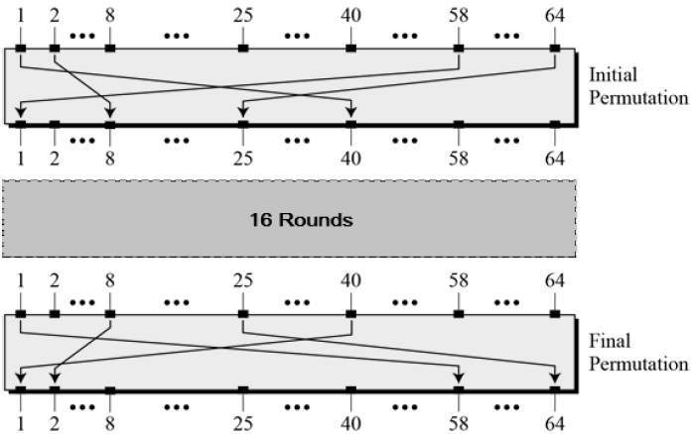
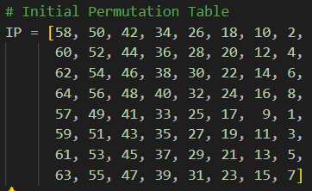
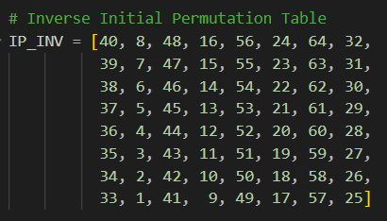
INITIAL & FINAL PERMUTATIONS
Initial Permutation (IP) and Final Permutation (FP) involve rearranging 64 bits of data using fixed tables.
This rearrangement adds complexity and randomness to the data, making it harder to decrypt without the key.
IP shuffles the plaintext at the beginning, by mapping the input bit to different output bits. FP reverses this process at the end of encryption, by using the inverse of the mapping.
Advantages: IP and FP enhance security by
introducing confusion and diffusion, making
encrypted data less predictable to attackers.

Slide 5
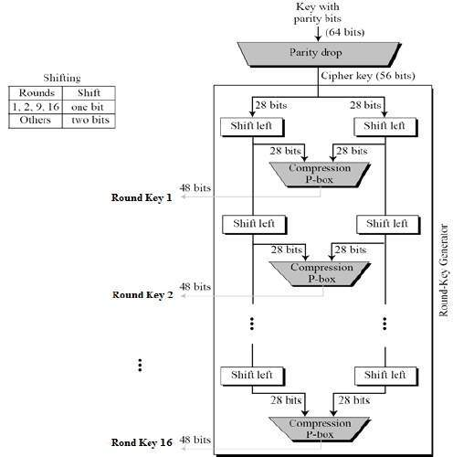
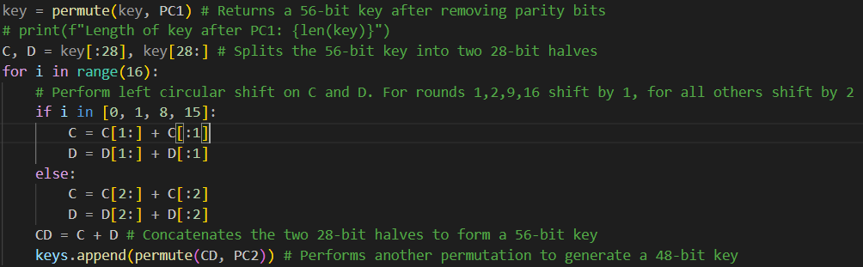
KEY GENERATION
Initially, the 64-bit key undergoes the removal of its. Parity bits, resulting in 56-bits.
This 56-bit key is fed into the key generator, which generates different 48-bit keys for each of the 16 rounds.
The keys are left-shift to generate 28 bits. These further undergo a permutation in the compression box to generate the 48-bit keys.

Slide 6
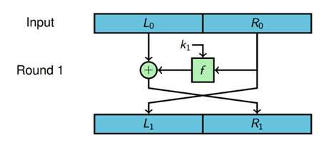
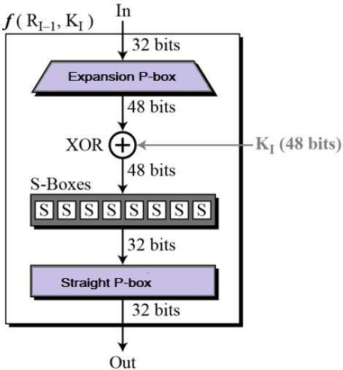
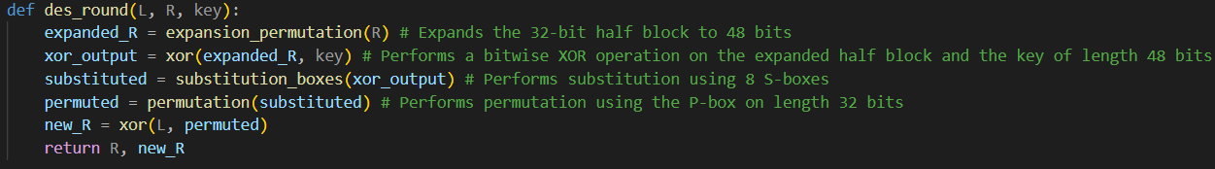
FIESTEL STRUCTURE (16 ROUNDS)
The F-Box within the Fiestel structure operates by taking the left sub-part (32 bits) from the previous round.
Expansion P-Box: It begins with an Expansion P-Box, which enlarges the 32-bit input to 48 bits by adding the 1st and last bit of each 4-bit packet to make a 6-bit packet.
XOR with Key: The expanded input is XORed with the corresponding round key, introducing variability based on the key.
S-Box: Next, the data undergoes S-Box shrinkage, where 48 bits are processed through unique substitution boxes, resulting in a reduction to 32 bits. The value is output as per the S-box, depending on the cell chosen in S-box
Final P-Permutation: Finally, the 32 bits from the S-Box stage undergo a Final P-Box Permutation, rearranging the bits to achieve diffusion and complexity.

Slide 7
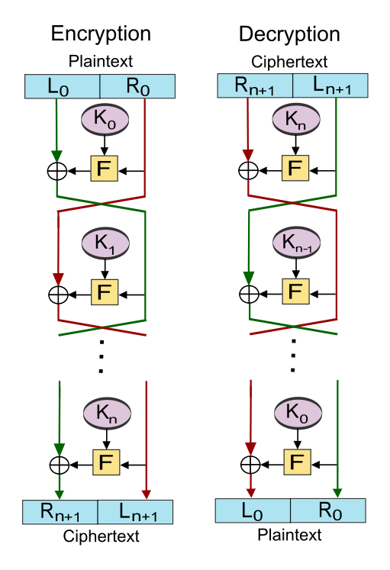
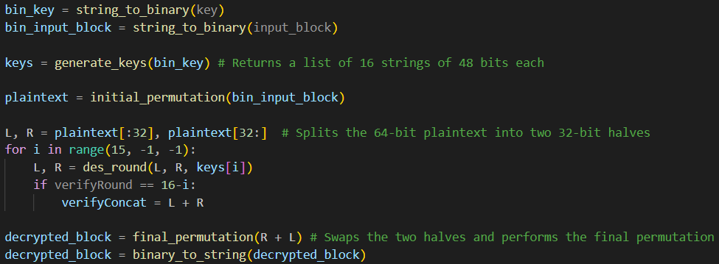
DECRYPTION STEPS
Inverse (Final)
Permutation
Key Generation
Reverse
16 Fiestel Rounds
Initial Permutation of Encryp.

Slide 8
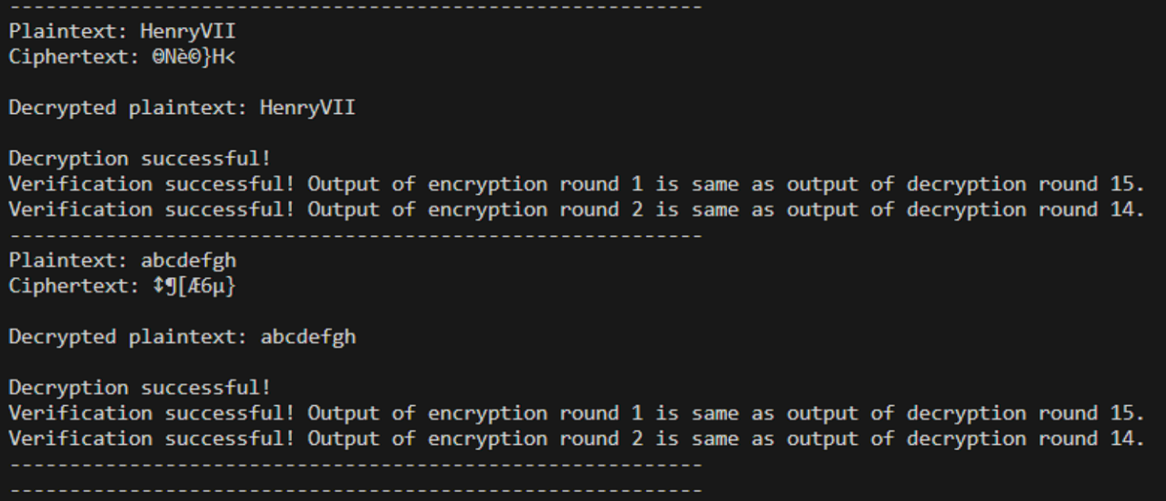
VERIFICATION

Slide 9

PRESENTED BY
AAMLEEN AHMED (2020002)
MOHAMMAD SUFYAN AZAM (2020312)
THANK YOU VERY MUCH!
NETWORK SECURITY - PROJECT 2

